Slide 1
Project Analysis

Slide 2
Project analysis slide 6
Analysis Measurements
Sales amongst years
Customer satisfaction
Geographical Distribution
Category – Segment indications
Time measures
Forecasted Sales

Slide 3
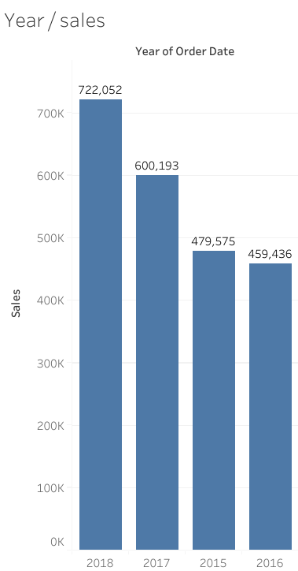
Project analysis slide 2
Total Sales each year
Significant Sales Growth in
2018
saw a substantial increase in sales, reaching a peak of 722,052. This represents a notable achievement compared to previous years, suggesting that the company experienced significant growth or success in its operations during this period.
Consistent Sales Performance in Recent Years:
2016
had the lowest sales figure at 459,436, it's important to note that the overall sales performance has remained relatively consistent over the past few years. This indicates a stable market presence and a lack of major fluctuations in sales volume.

Slide 4
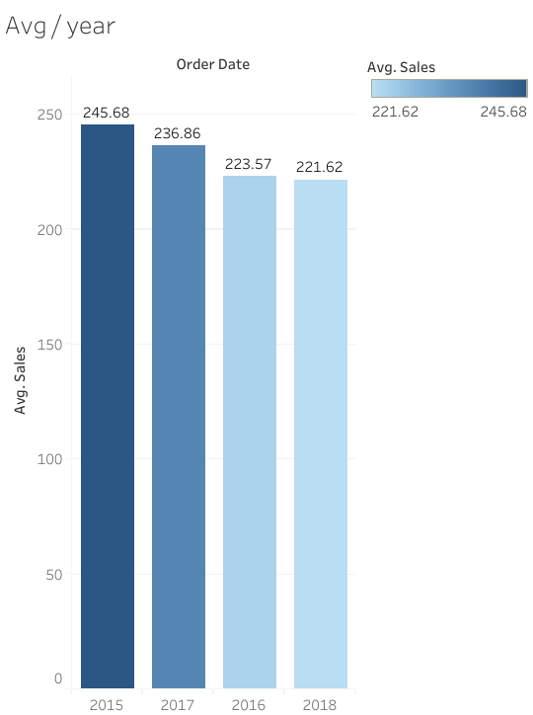
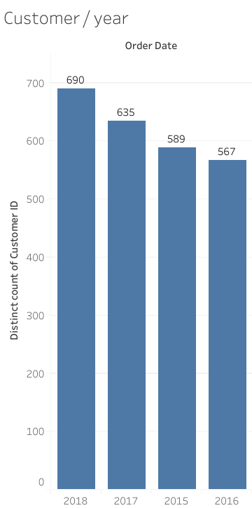
Project analysis slide 3
Customers and Average Sales each year
Consistency
Overall, the charts demonstrate a positive trend in both sales' performance and customer growth over the analyzed period. The company has successfully increased its customer base and maintained consistent sales levels, indicating a strong market presence

Slide 5
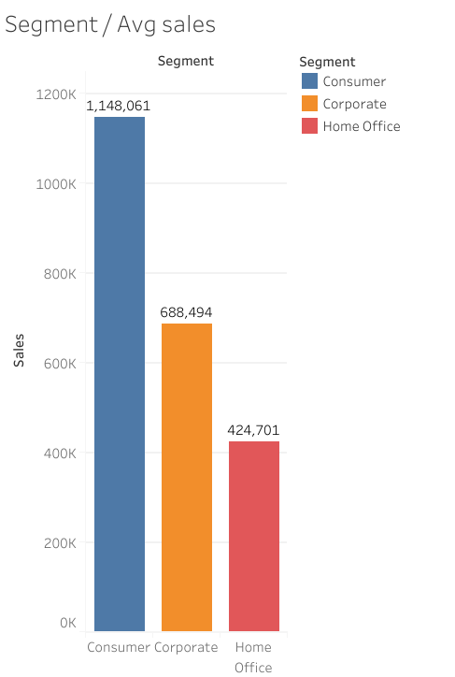
Project analysis slide 5
Average Sales by segment
Consumer
1,148,061
The Consumer segment has the highest average sales, significantly outperforming the Corporate and Home Office segments.
Home office
$ 424,701
The Home Office segment has the lowest average sales, indicating a potential need for targeted strategies to improve performance in this market.

Slide 6
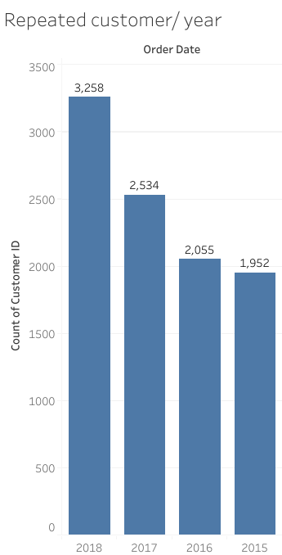
Project analysis slide 5
Repeated Customers each year
Paek year
2018
A positive trend in repeated customer purchases over the years, with a peak in 2018 and consistent performance in subsequent years. This indicates that the company has been successful in retaining and engaging its customer base, which is a strong indicator of customer satisfaction and loyalty.

Slide 7
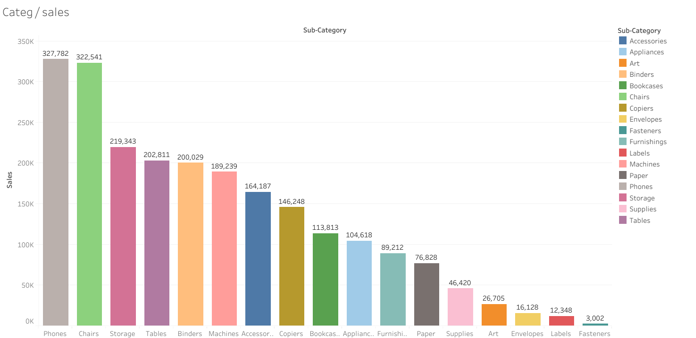
Project analysis slide 5
Total sales by Product
Phones and Storage Dominate Sales
The "Envelopes," “Labels," and "Fasteners"
$ 650,323
$ 31,478
Both are the highest sales figures, significantly outperforming the other sub-categories.
All have the lowest sales, indicating that they may be less in demand or have lower profit margins compared to other products.

Slide 8
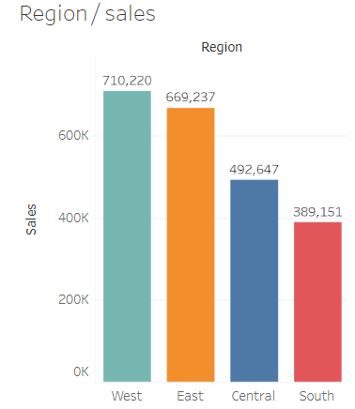
Project analysis slide 5
Total sales by region
significant regional variations in sales performance, with the West region demonstrating the highest sales volume and the South region reporting the lowest.
This suggests that factors such as market size, customer preferences, or regional economic conditions may be influencing sales distribution across different regions.

Slide 9
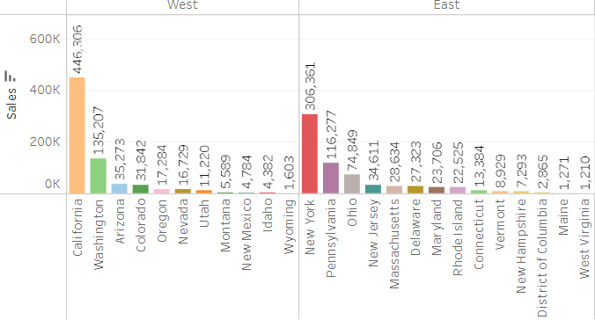
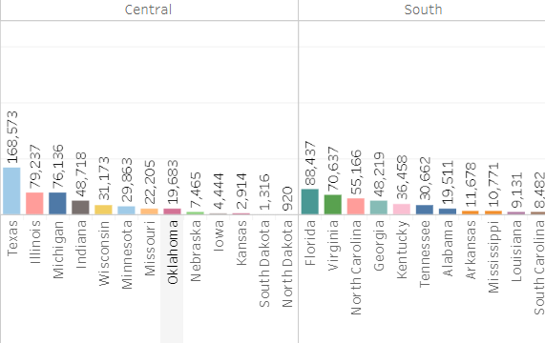
Total sales by state
The states with the highest sales in each region are:
West: California (416,506)
East: New York (306,361)
Central: Texas (168,573)
South: Texas (168,573)

Slide 10
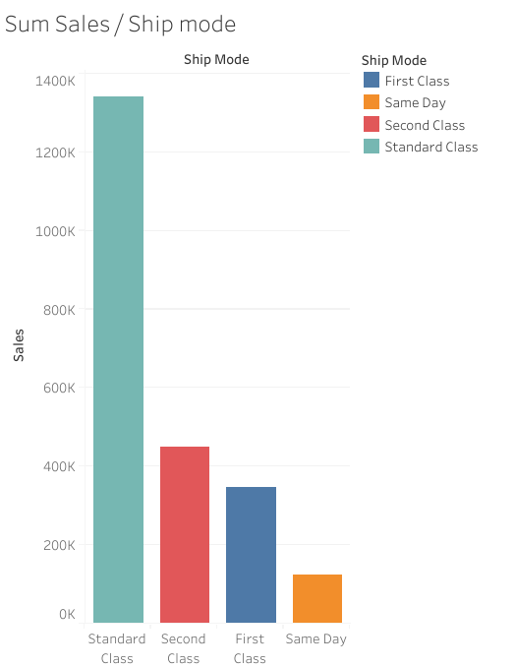
Project analysis slide 5
Total Sales by shipping mode
Standard Class Dominates in Sales:
has the highest total sales, significantly outperforming the other ship modes. This suggests that it is the most popular or cost-effective option for customers..
Same Day Delivery Has Lowest Sales
indicating that it may be less in demand due to higher costs or limited availability.

Slide 11
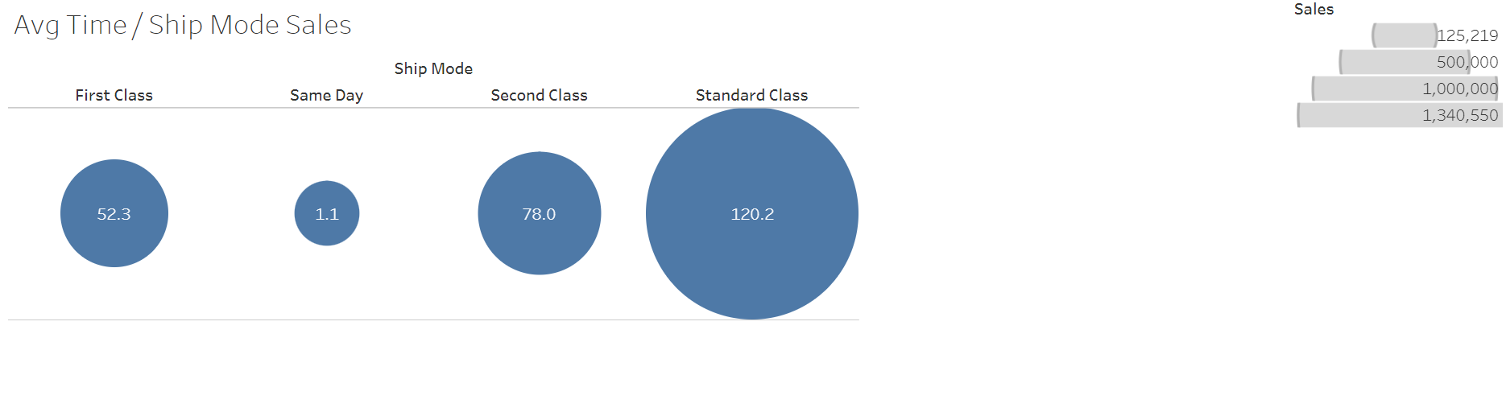
Project analysis slide 5
Customer Satisfaction
Standard Class Offers the Best Balance of Speed and Cost
Same Day Delivery is the Fastest but Least Popular
the highest average sales, suggesting that it is the most popular choice among customers. This might be due to its balance of delivery speed and affordability compared to other options.
the lowest average sales, likely because it is the most expensive and has the shortest delivery time. This may make it less attractive to customers who prioritize cost or are willing to wait for faster shipping options.

Slide 12
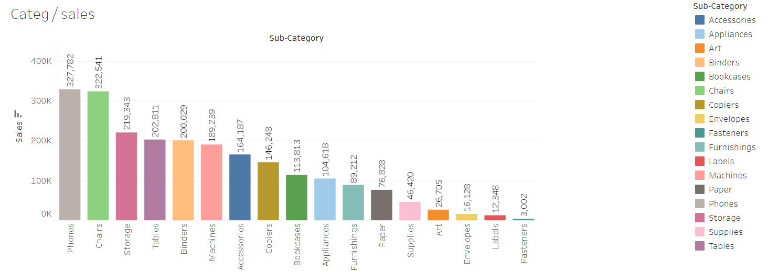
Project analysis slide 5
Categories generate the highest sales
Phones and Chairs Dominate Sales
Wide Variation in Sales Performance
$ 650,323
The "Envelopes," “Labels," and "Fasteners" sub-categories have the lowest sales, indicating that they may be less in demand or have lower profit margins compared to other products.
The both highest sales figures, significantly outperforming the other sub-categories. This suggests that these products are particularly popular or have higher profit margins.

Slide 13
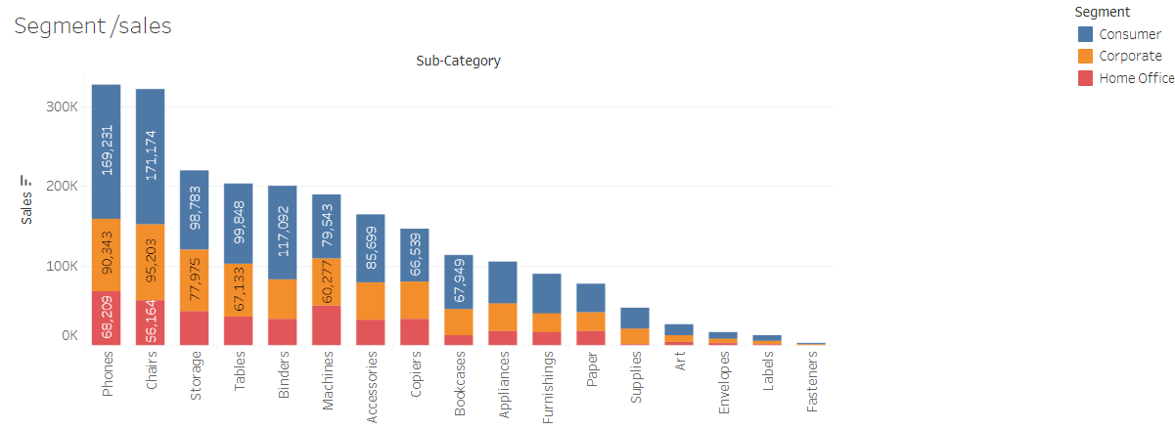
Project analysis slide 5
Top sellers by Segment
A detailed breakdown of sales performance across different product categories and customer segments
- The Consumer segment consistently outperforms the Corporate and Home Office segments in terms of sales volume for most product categories.
- The "Phones" and “Chairs" categories consistently rank among the top-selling products across all segments.
- the Corporate segment may have higher demand for certain office supplies or equipment, while the Home Office segment may focus on products for home-based work or personal use.
- The company could focus on promoting Phones and Chairs to all segments, while tailoring other product offerings to specific customer needs.

Slide 14
Project analysis slide 10
Forecasted Sales
a clear upward trend in forecasted sales from December 2018 to January 2020
there are some fluctuations throughout the period
the overall direction indicates a positive outlook for future sales growth

Slide 15
Thank You

